Slide 1
CSC529: Advanced Data Mining
Lecture 9
Probabilistic Graphical Models

Slide 2
Lecture Outline
Motivation: Sequential data
Markov Models: basic concepts
Hidden Markov Models (HMM): basic concepts
Examples of HMM
Type of problems solved with HMM
HMM in Matlab
References

Slide 3
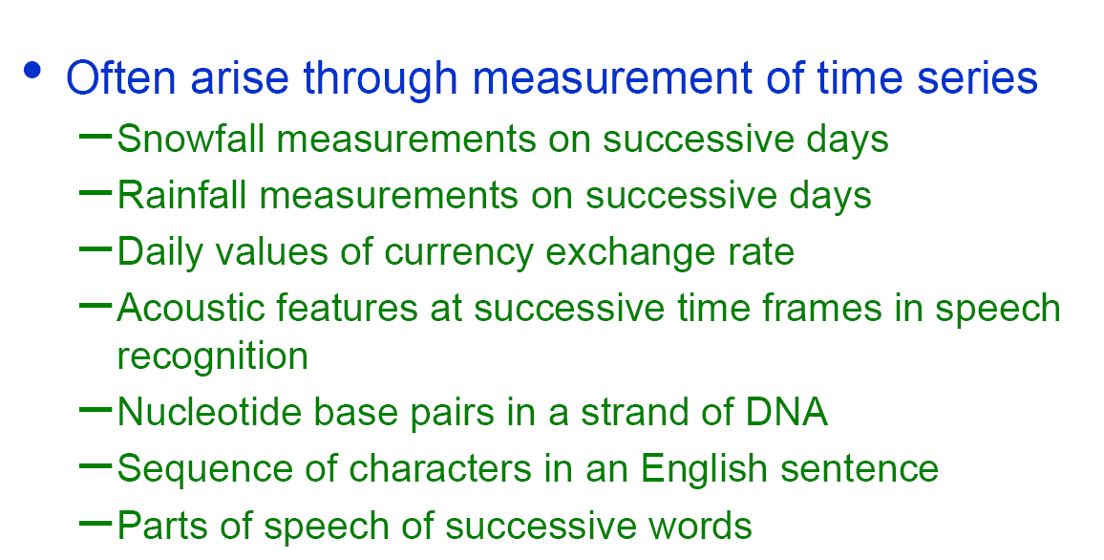
Sequential Data Examples

Slide 4
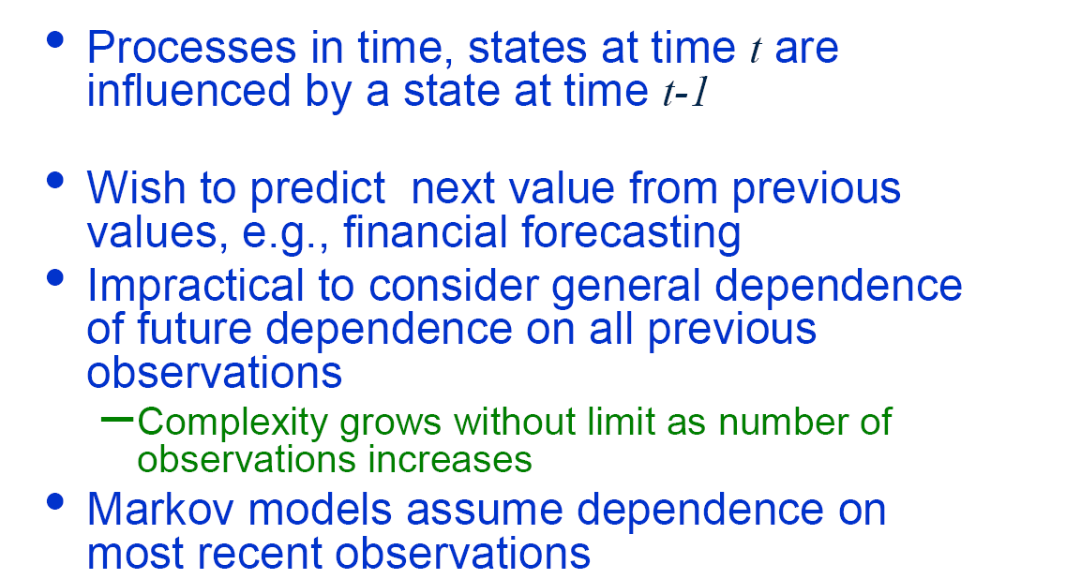
Making a Sequence of Decisions

Slide 5
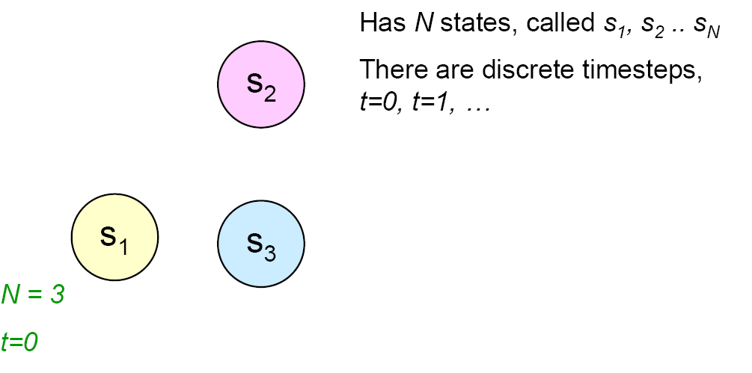
A Markov Model

Slide 6
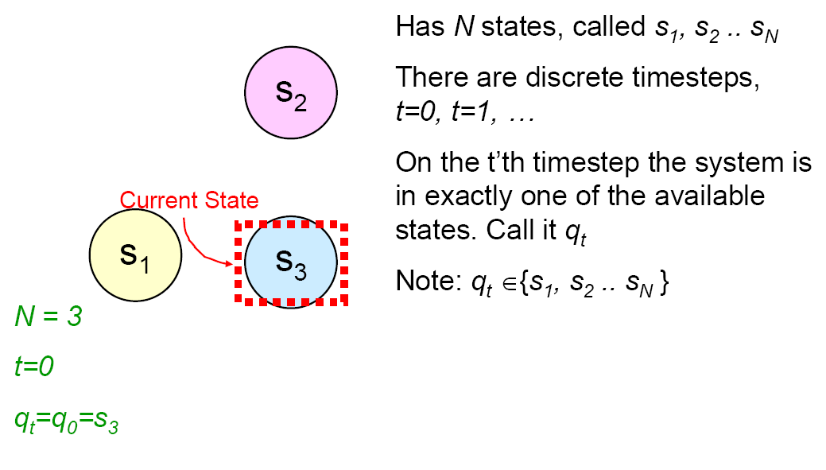
A Markov System

Slide 7
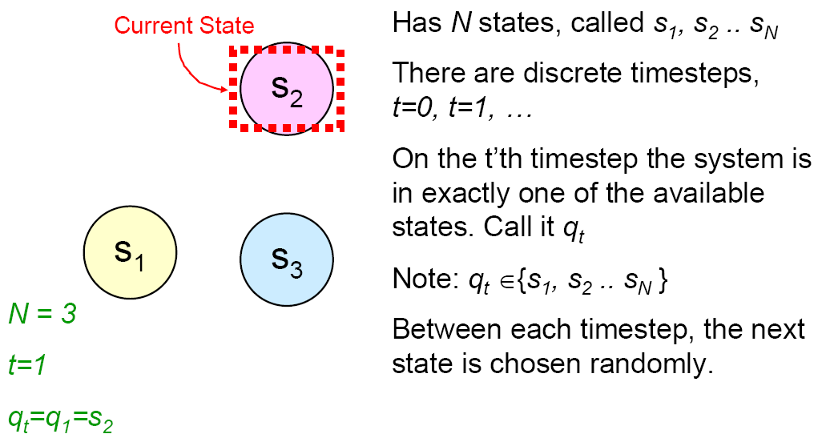
A Markov System

Slide 8
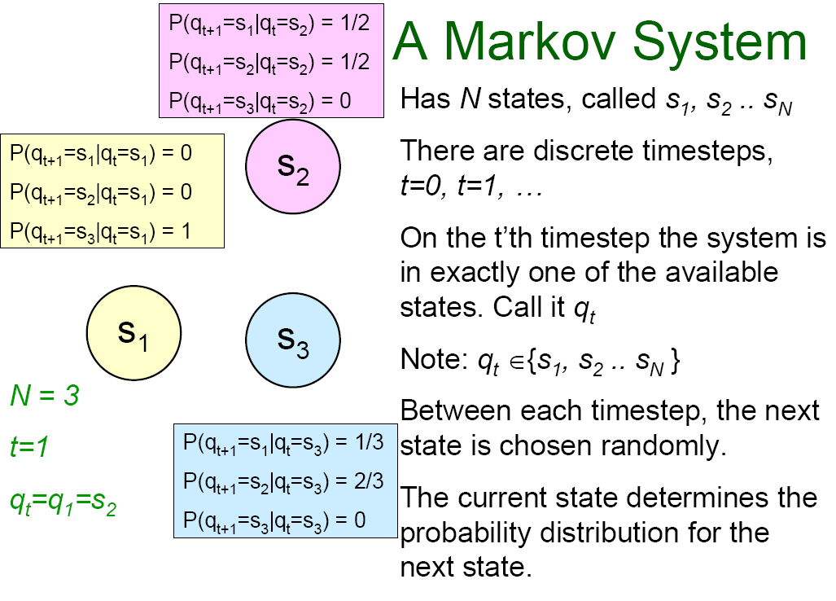

Slide 9
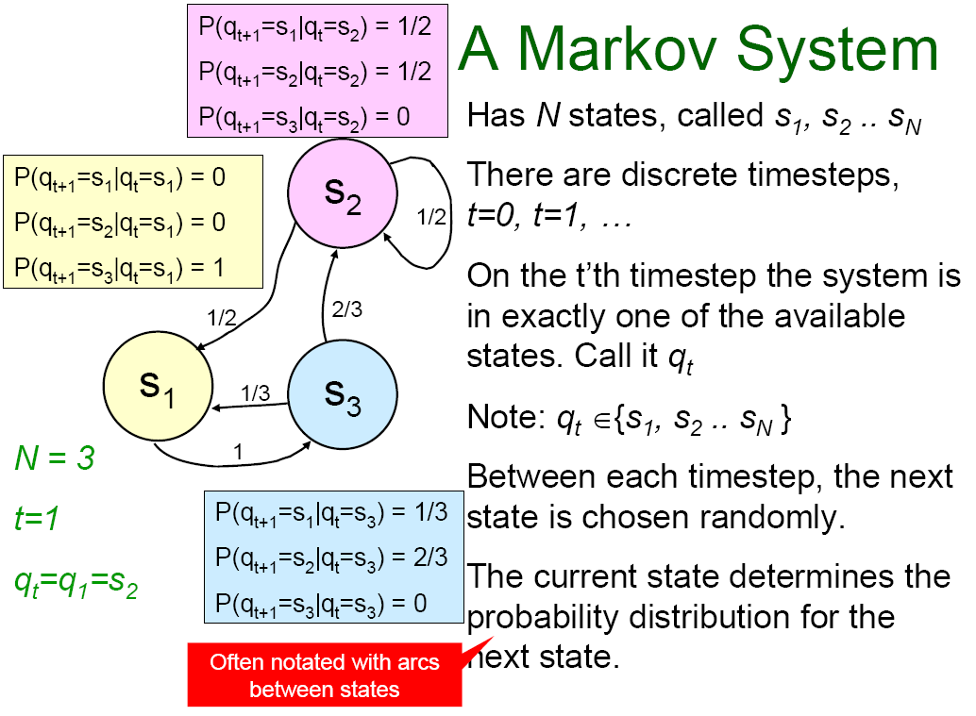

Slide 10
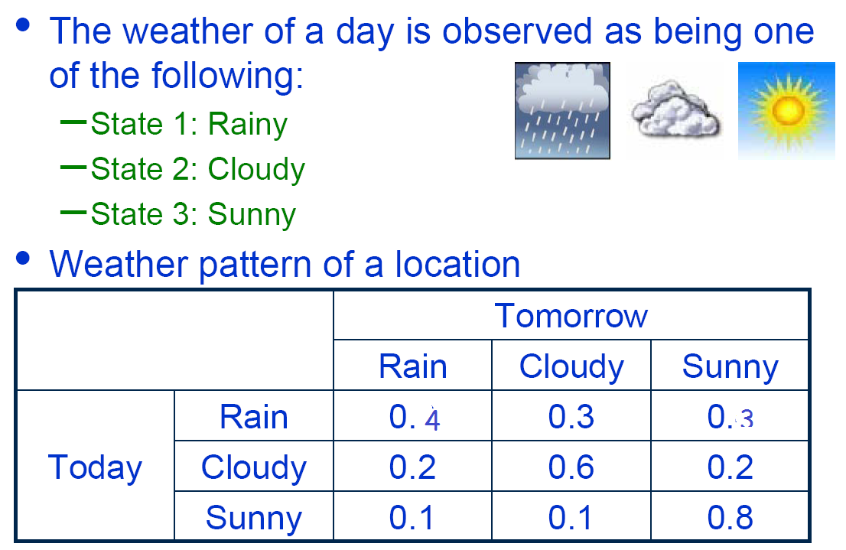
Markov System – Weather Example
6:33

Slide 11
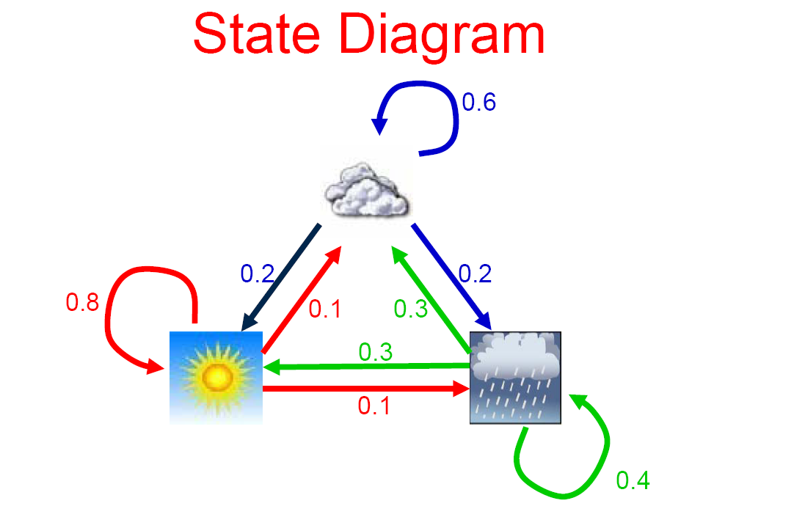
Markov System – Weather Example

Slide 12
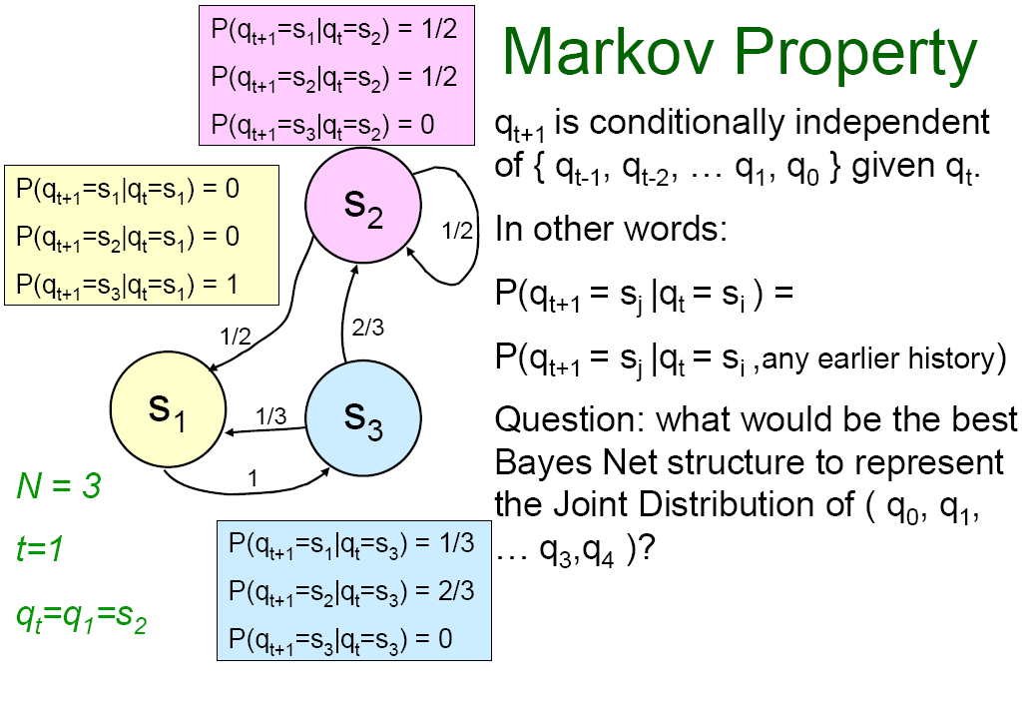

Slide 13
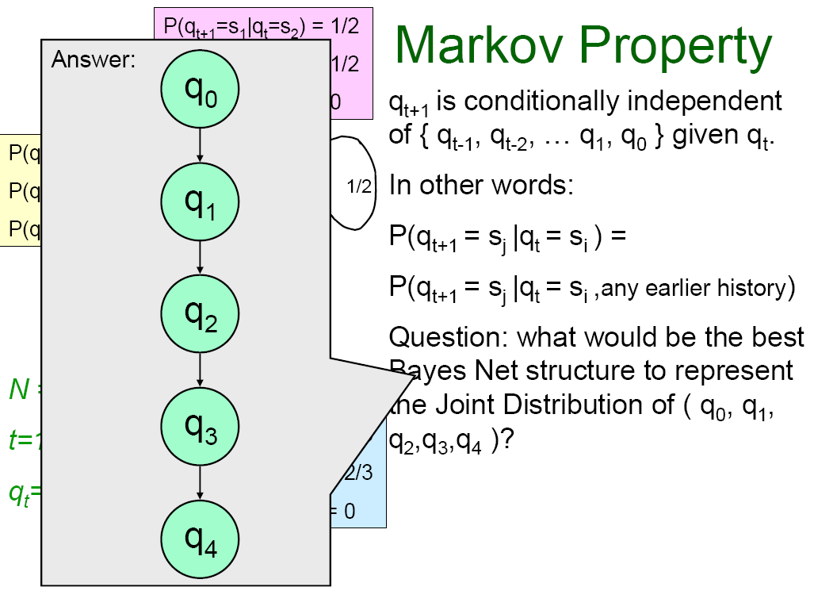

Slide 14
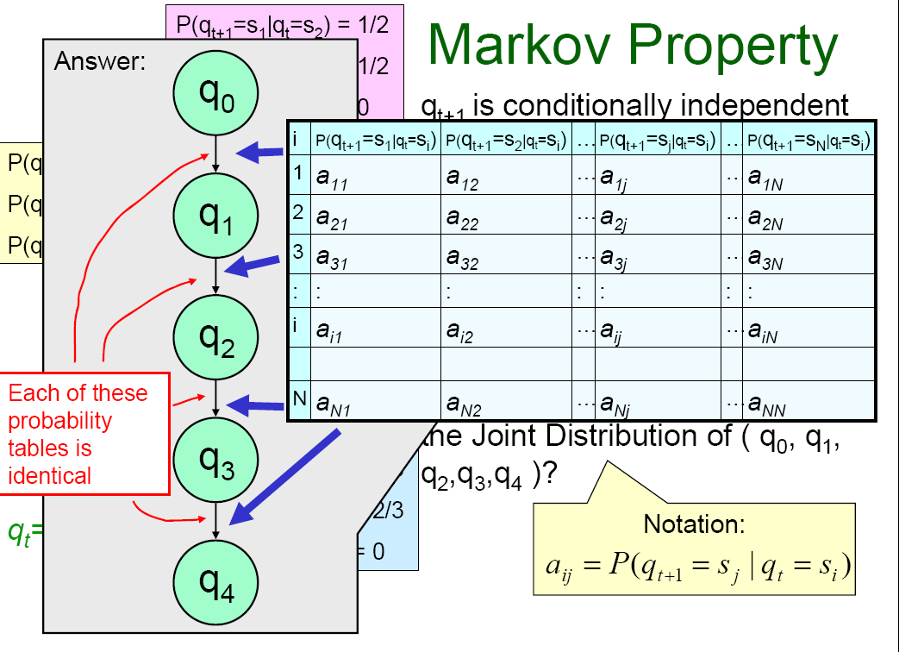
6:39
Notes:
a(ij) is the coefficient of the the transitions matrix

Slide 15
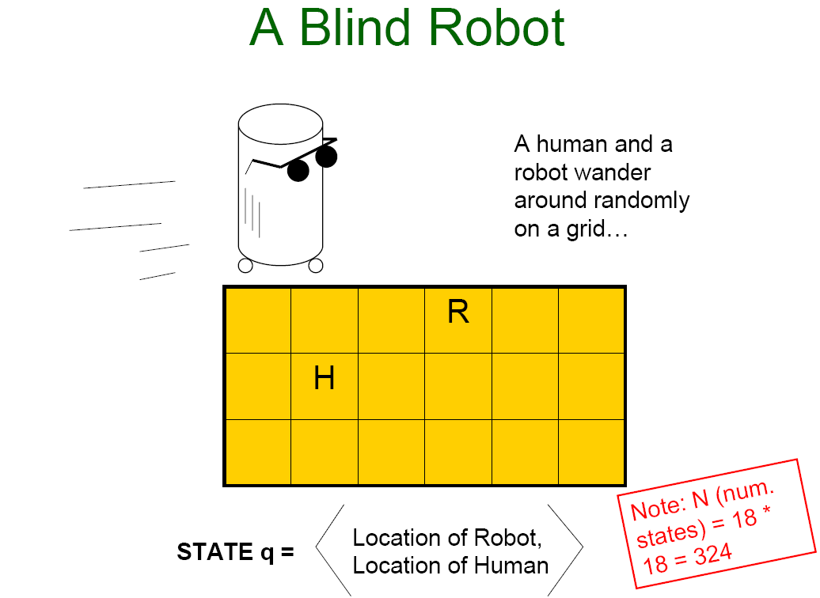
6:44
Notes:
The cuve 6x3 has 18 positions. That adds to 324 combinations
H = Human
R = Robot

Slide 16
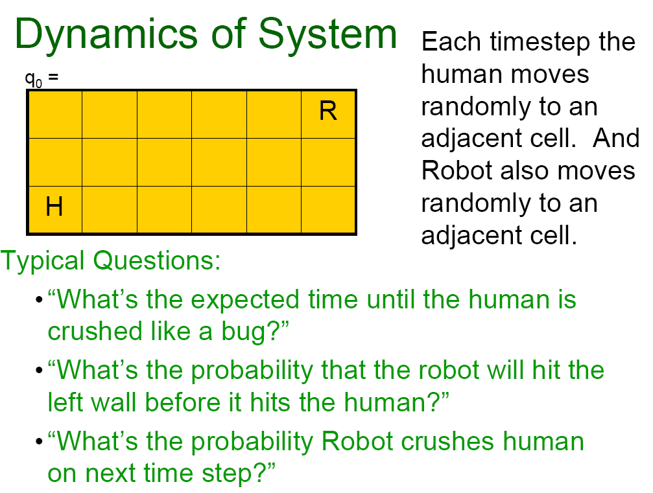

Slide 17
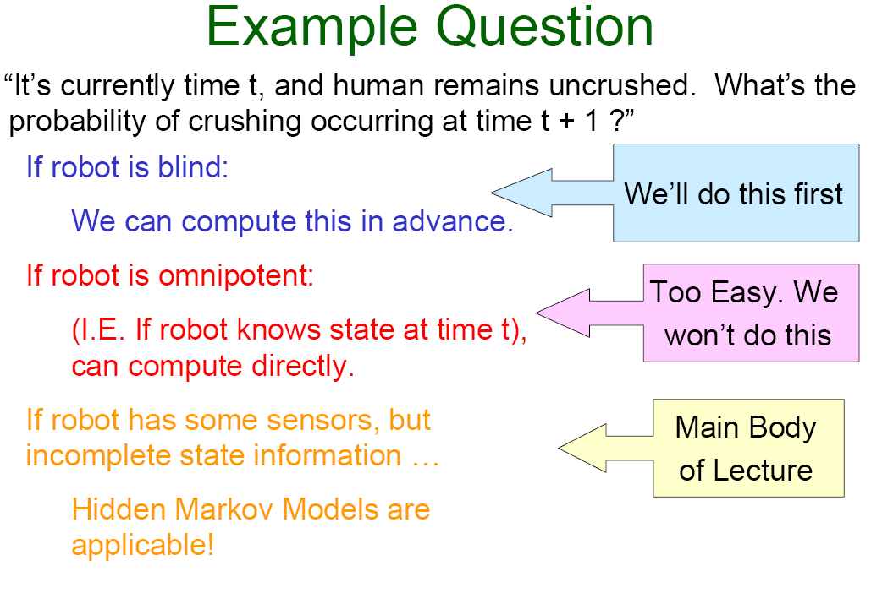
6:47

Slide 18
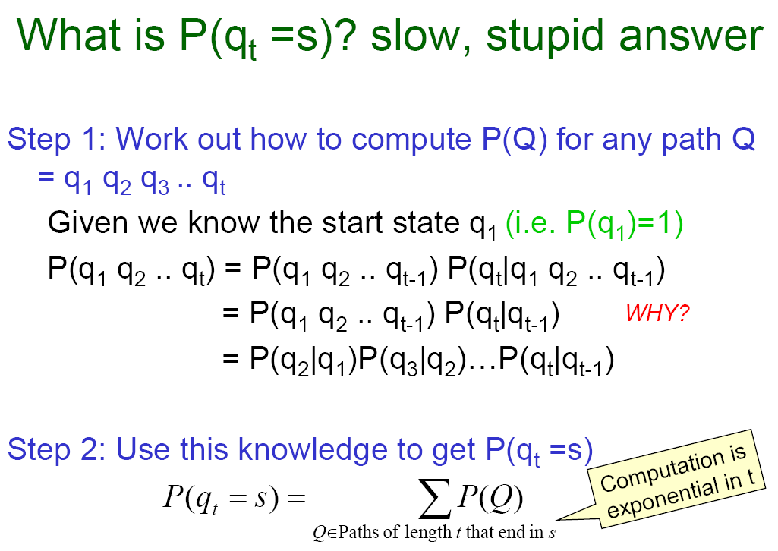
6:50

Slide 19
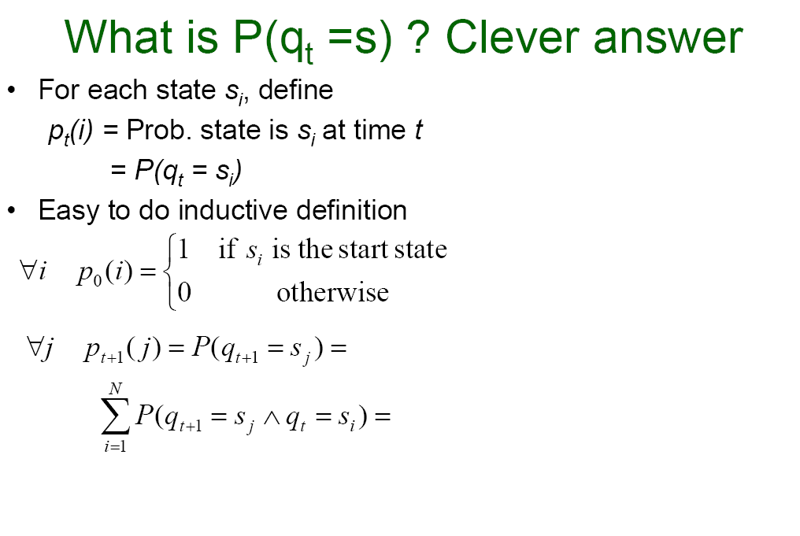
6:57
Notes:
^ means and.
We look only at the parent states to compute the probability

Slide 20
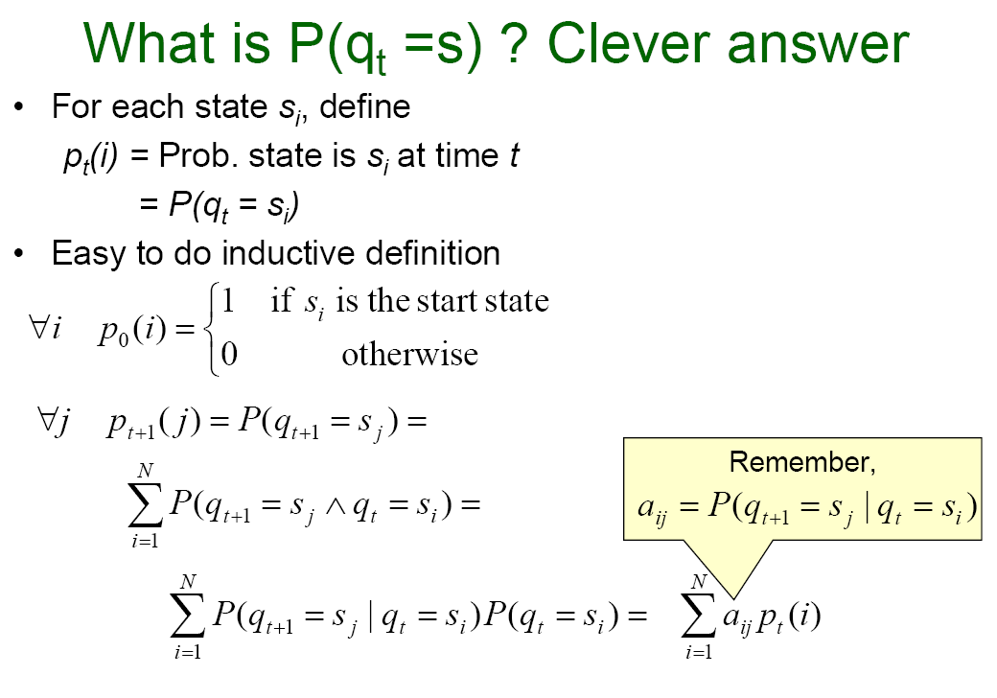
Notes:
For thr last formula we use the knowledge of P(A,B) = P(B|A)

Slide 21
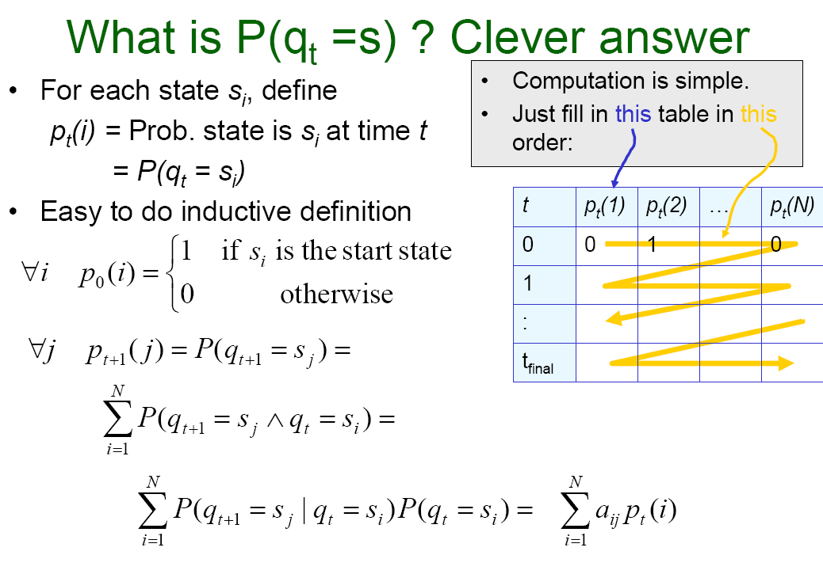
7:04

Slide 22
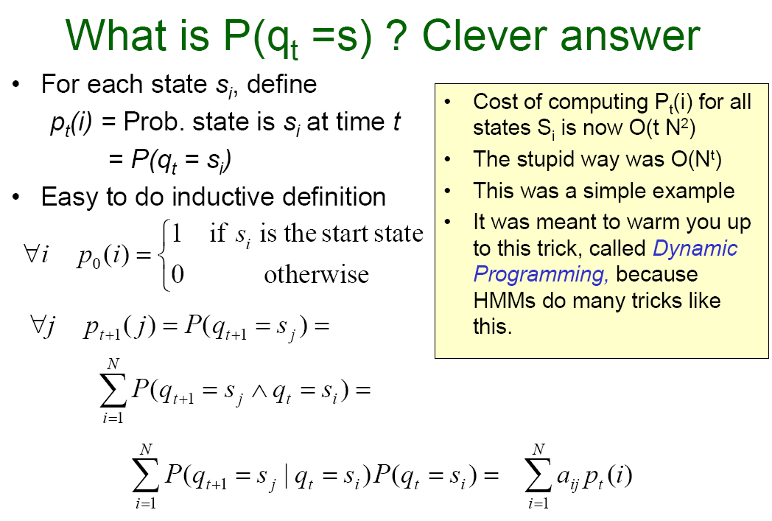
Notes:
HMM Hidden Markov Models

Slide 23
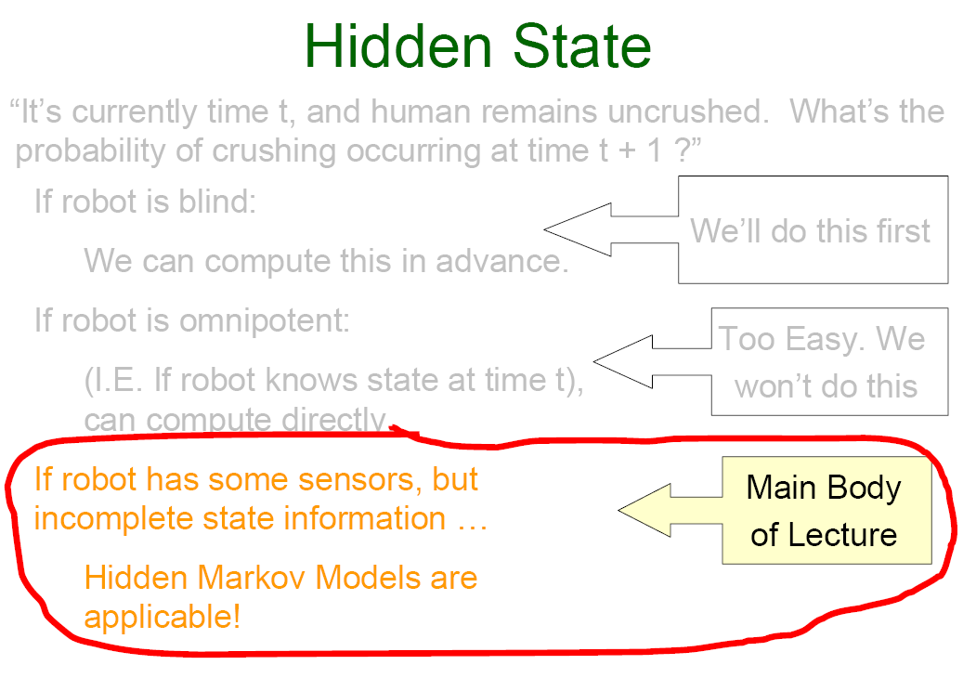
7:07
Notes:
Now we assume that the robot has sensors but know nothing beyond those states

Slide 24
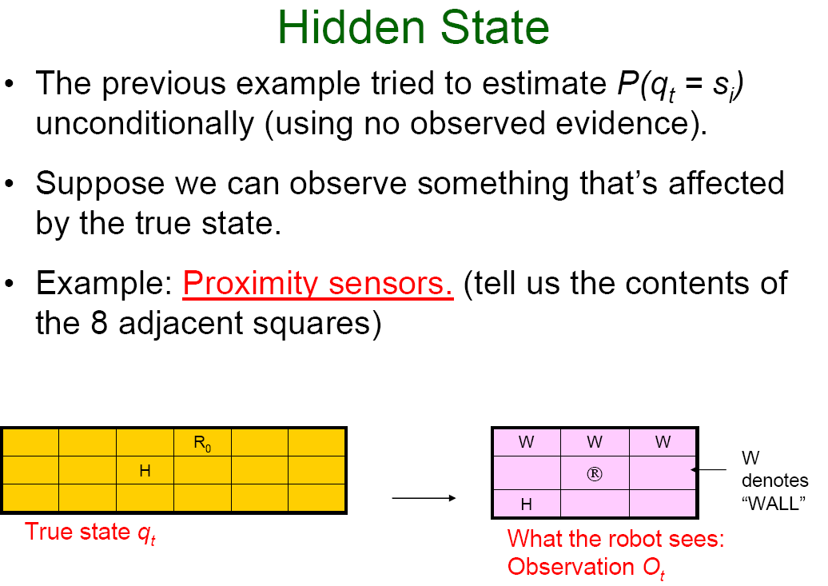
7:08

Slide 25
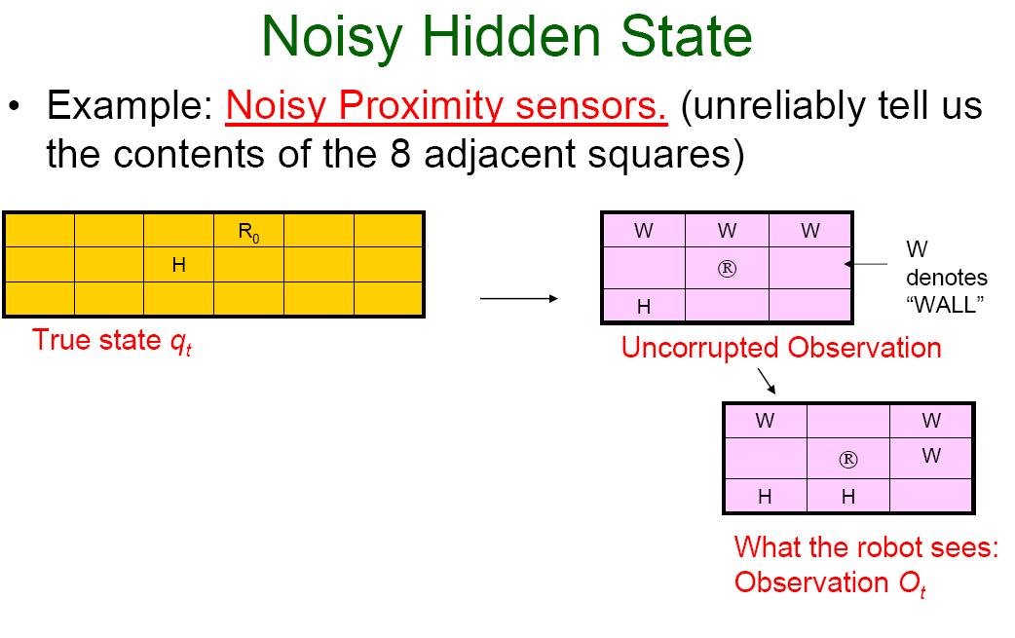

Slide 26
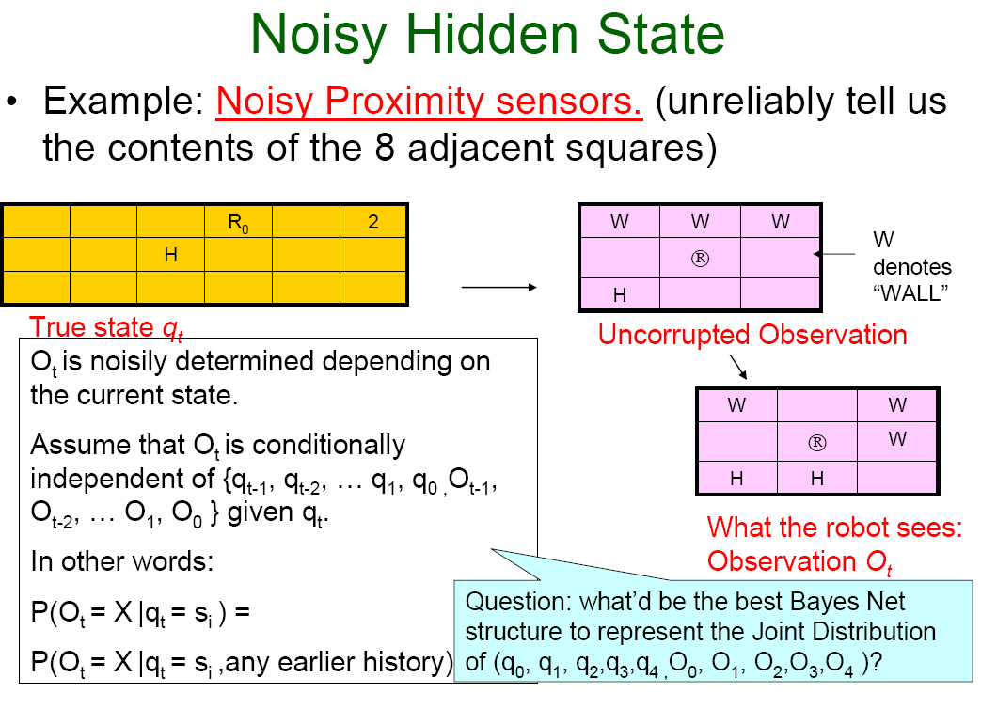

Slide 27
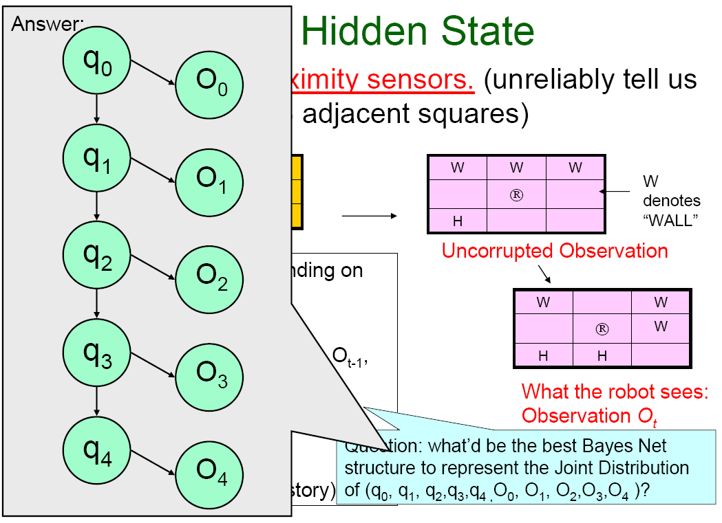

Slide 28
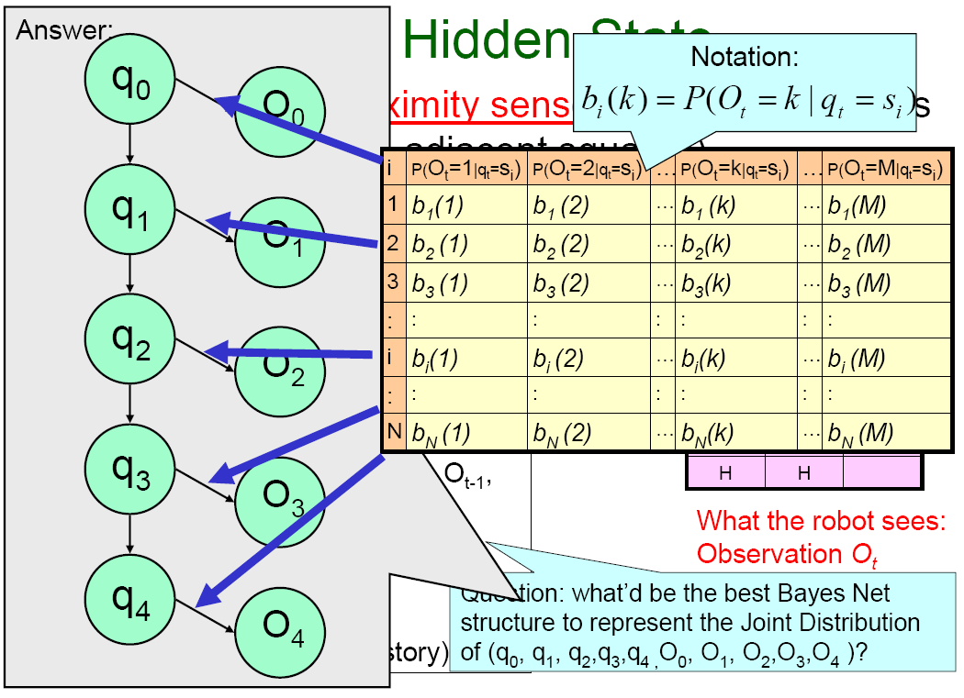
7:16
Notes:
Bi(k) stands for the probability that I will observe a t time t, k given that at time t I have state s(i)
Probability os observing k given state s

Slide 29
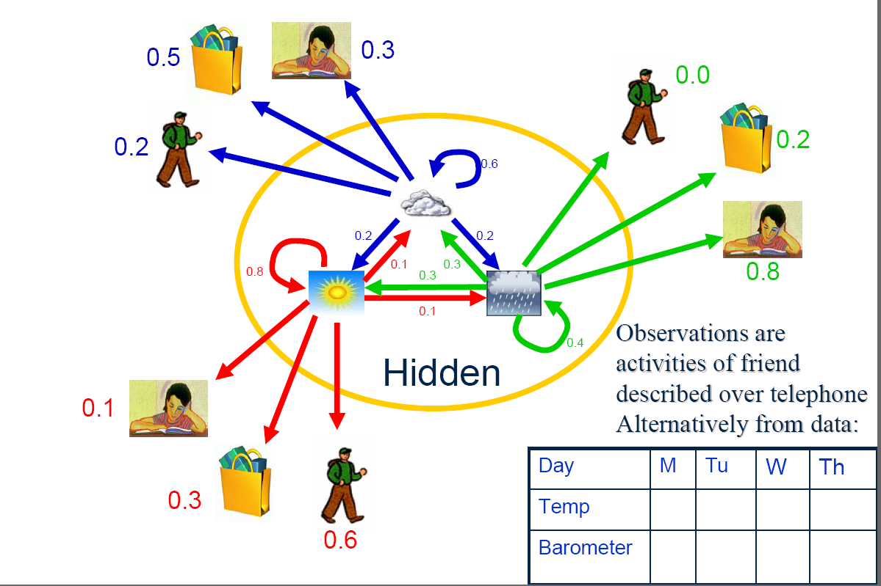
Hidden Markov Model – Weather Data

Slide 30
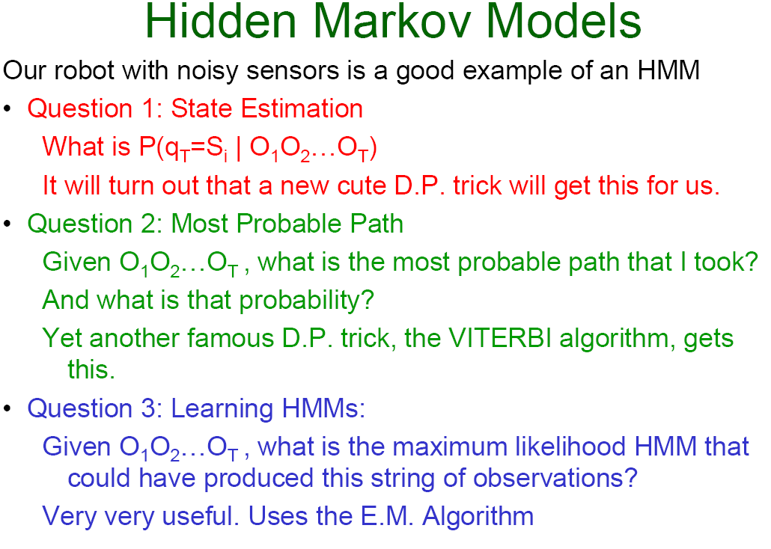
7:40
Notes:
HMM goof for
state estimations P(q_{t}=s_{i}| O₁O₂…O_{t)}
path estimations P(Q | O₁O₂…O_{t)}) , the one with the higest probability is the best
Learning HMM

Slide 31
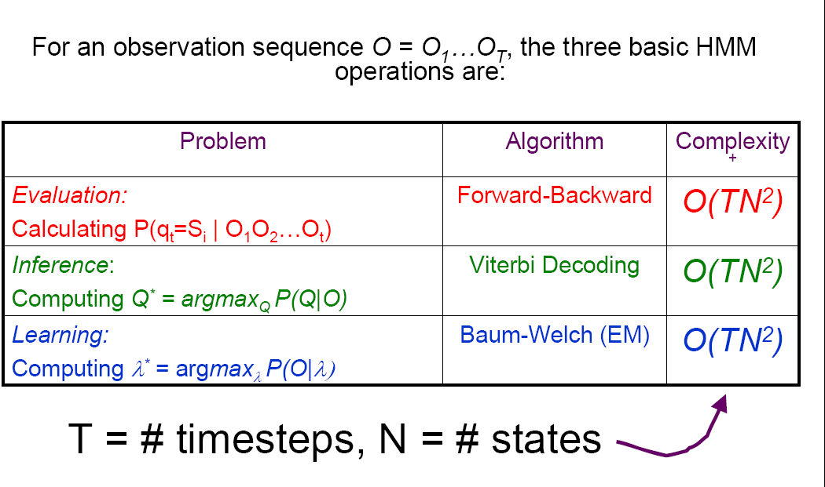
Basic Operations in a HMM
7:44
Notes:
Evaluation → State estimations → Forward-backward
Inference → paths estimation → Viterbi
Learning → lambda, maximize probabilities → Baum-Welch

Slide 32
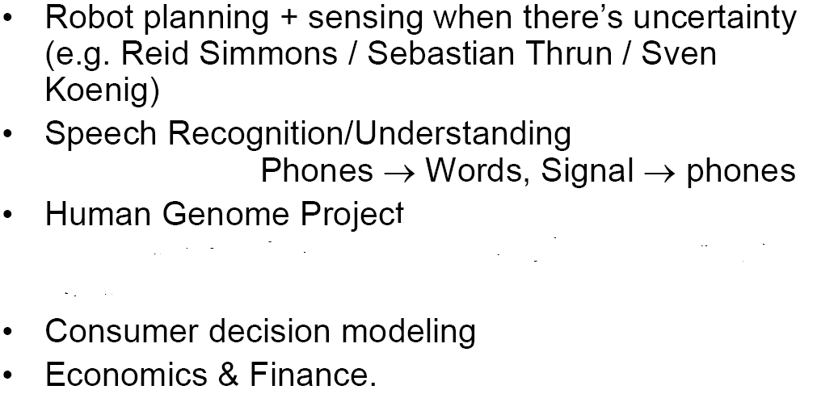
HMM Applications

Slide 33
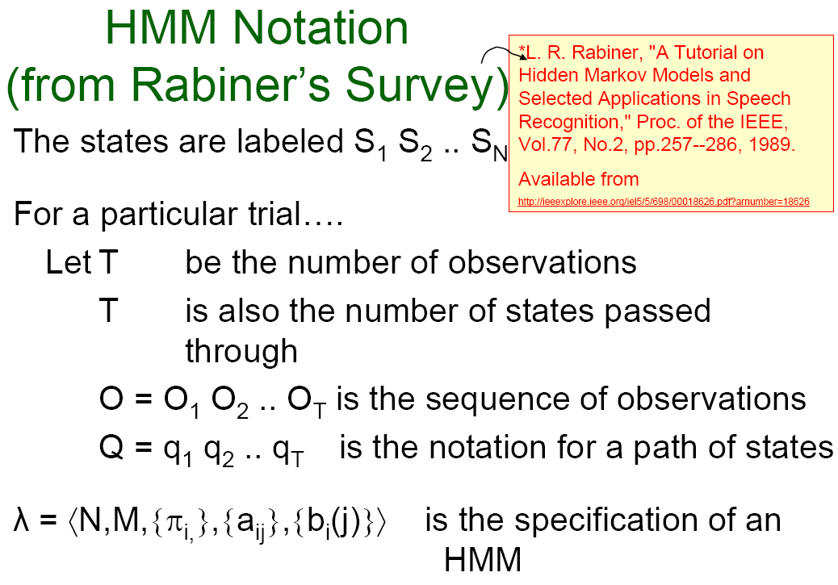
7:50
Notes:
N = number of states
M = number of possible observations
Pi_{i} = state probabilities
A_{ij} = transition matrix
B_{i}(j)

Slide 34
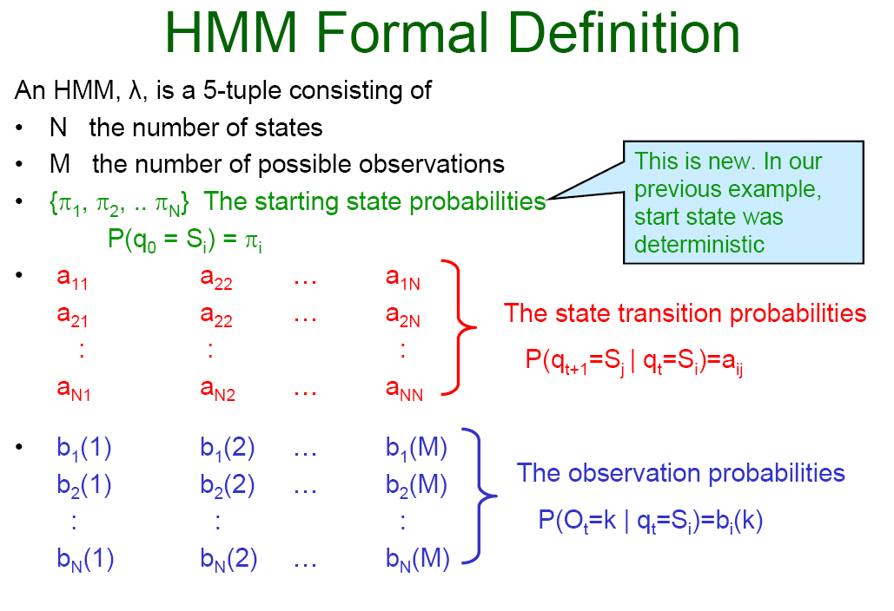

Slide 35
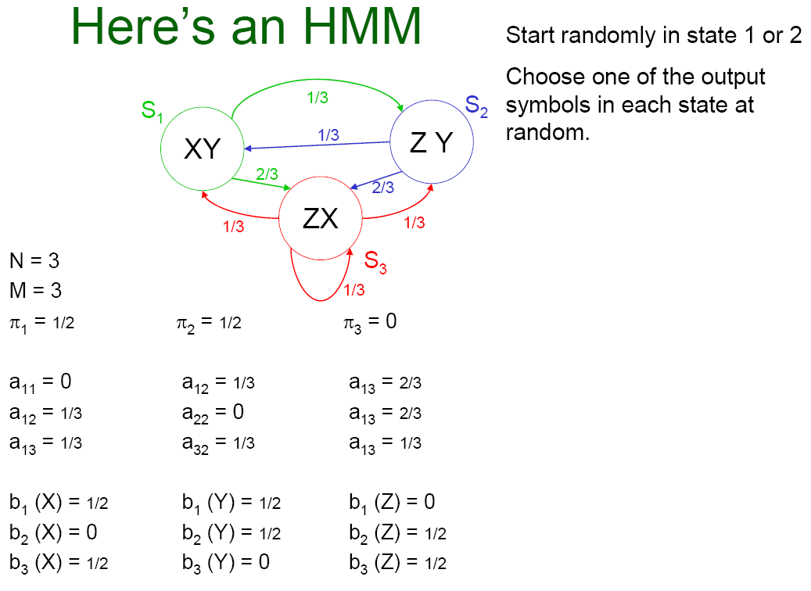
7:55

Slide 36
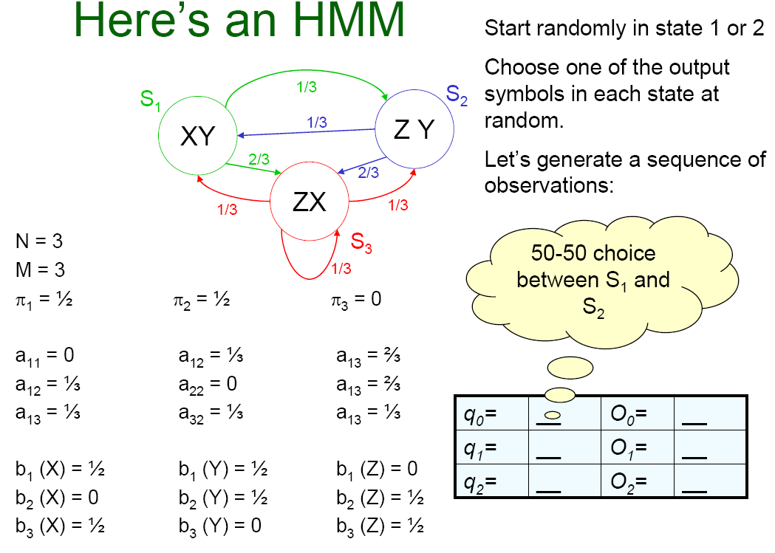
7:59

Slide 37
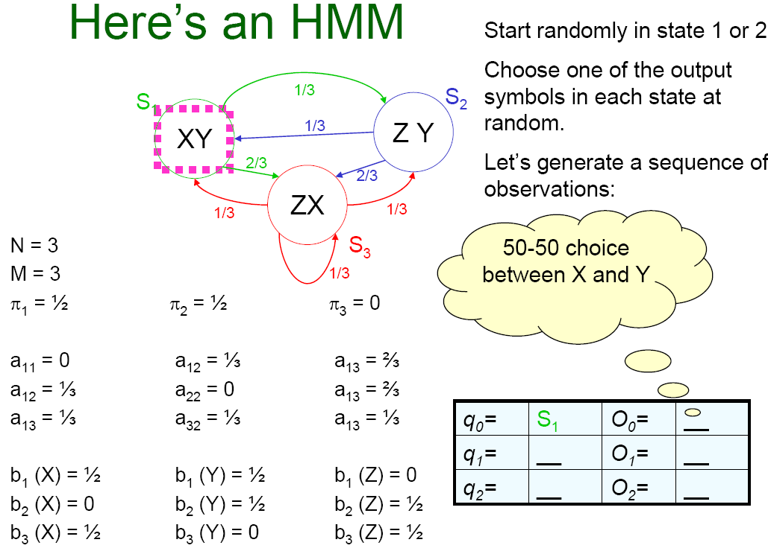

Slide 38
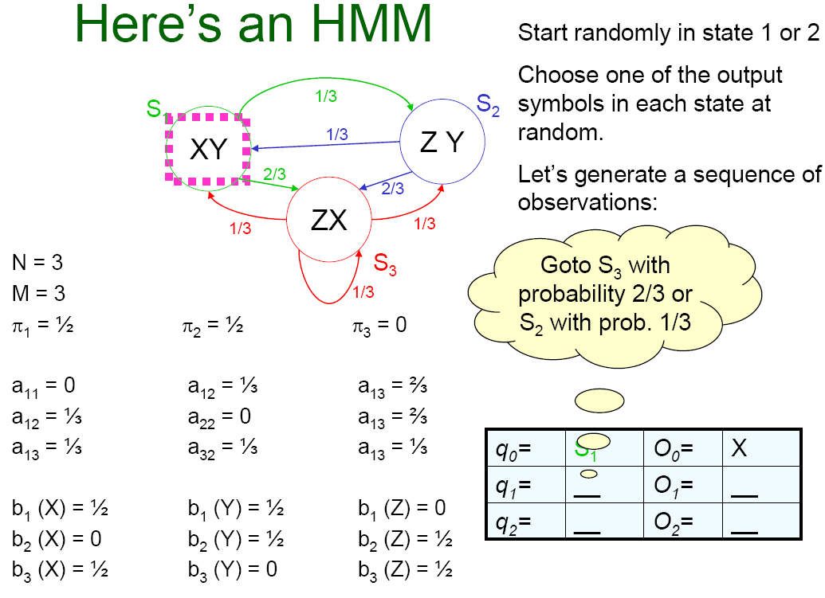

Slide 39
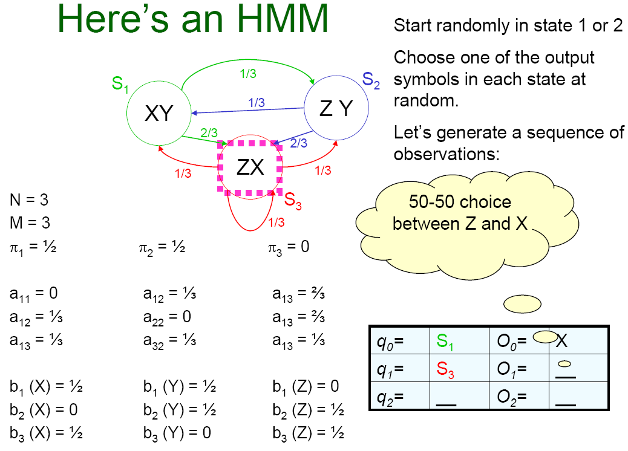

Slide 40
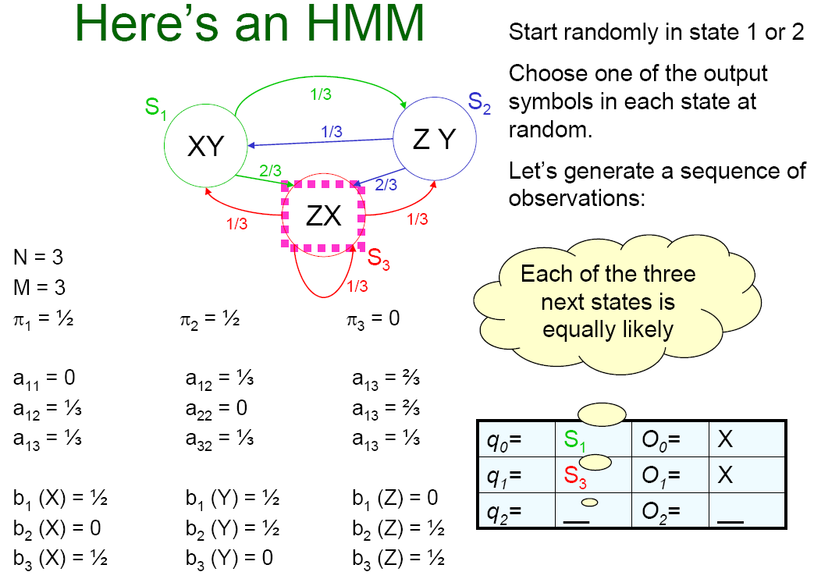

Slide 41
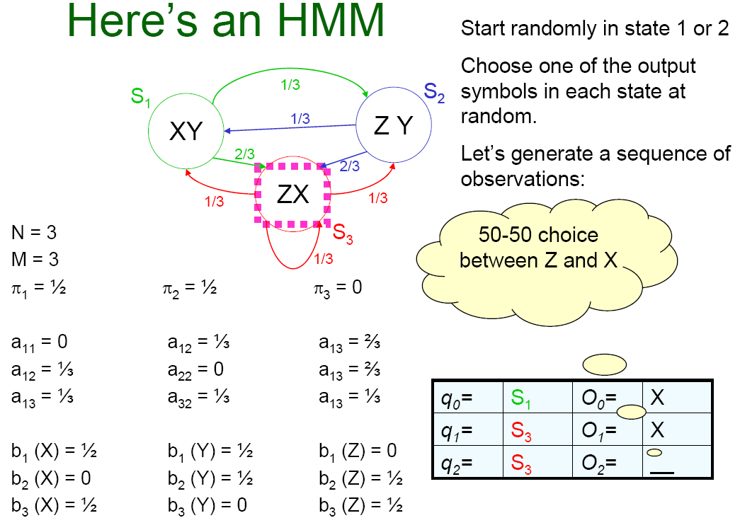

Slide 42
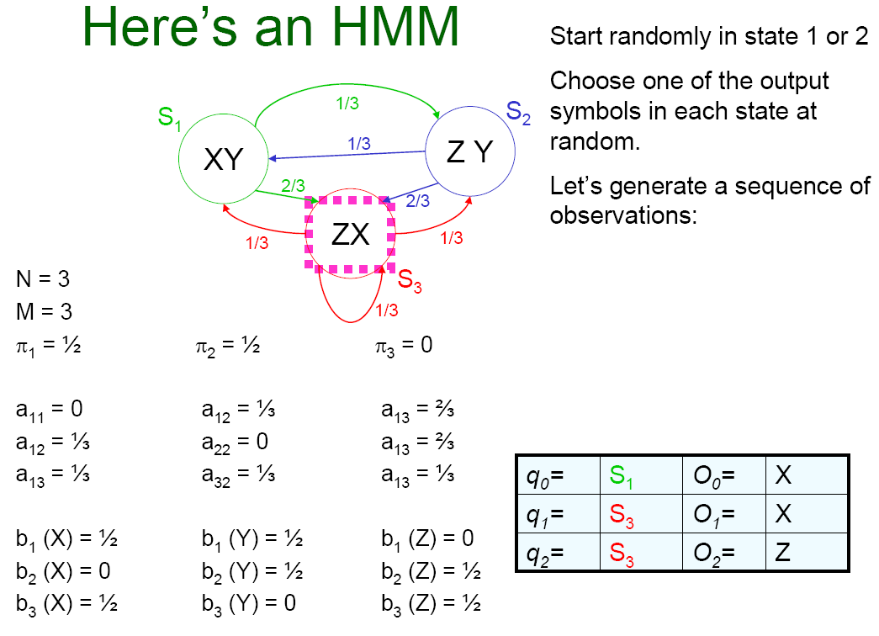

Slide 43
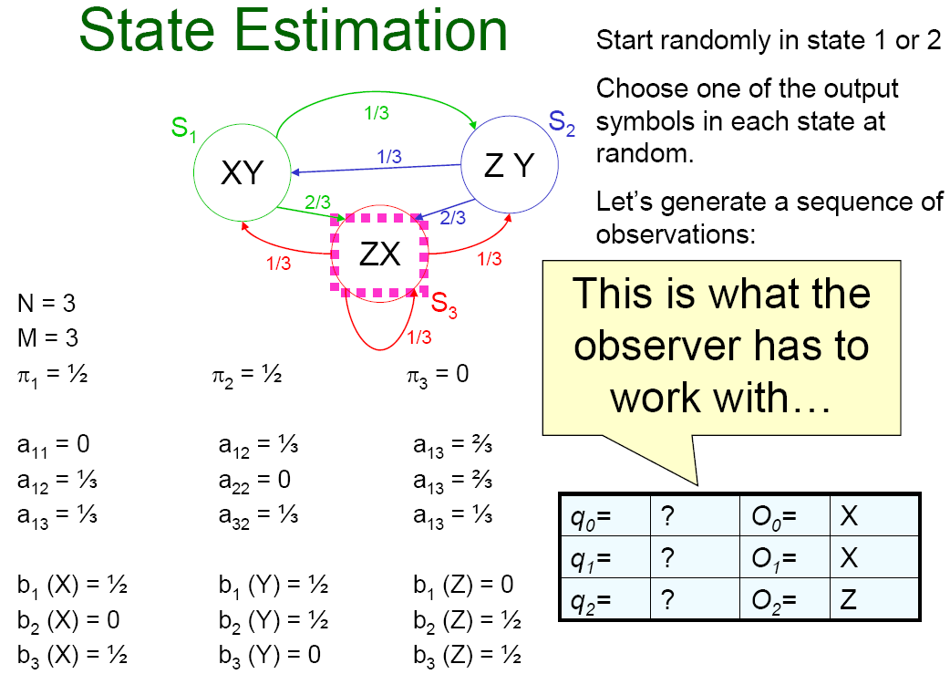
8:02

Slide 44
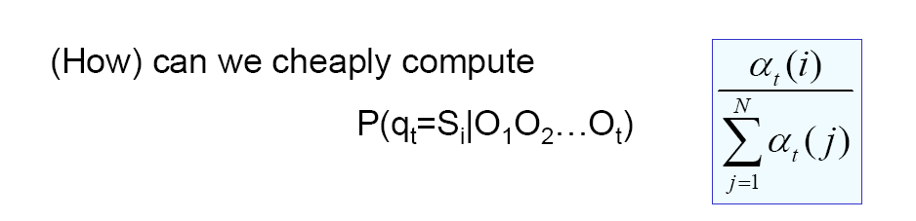
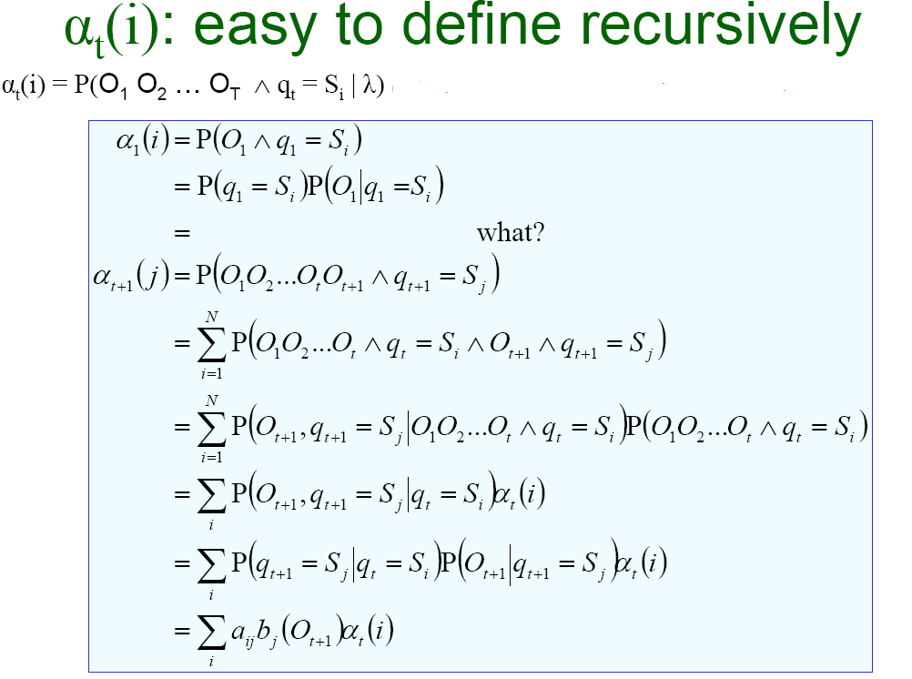
State Estimation
Forward- Backward Algorithm

Slide 45
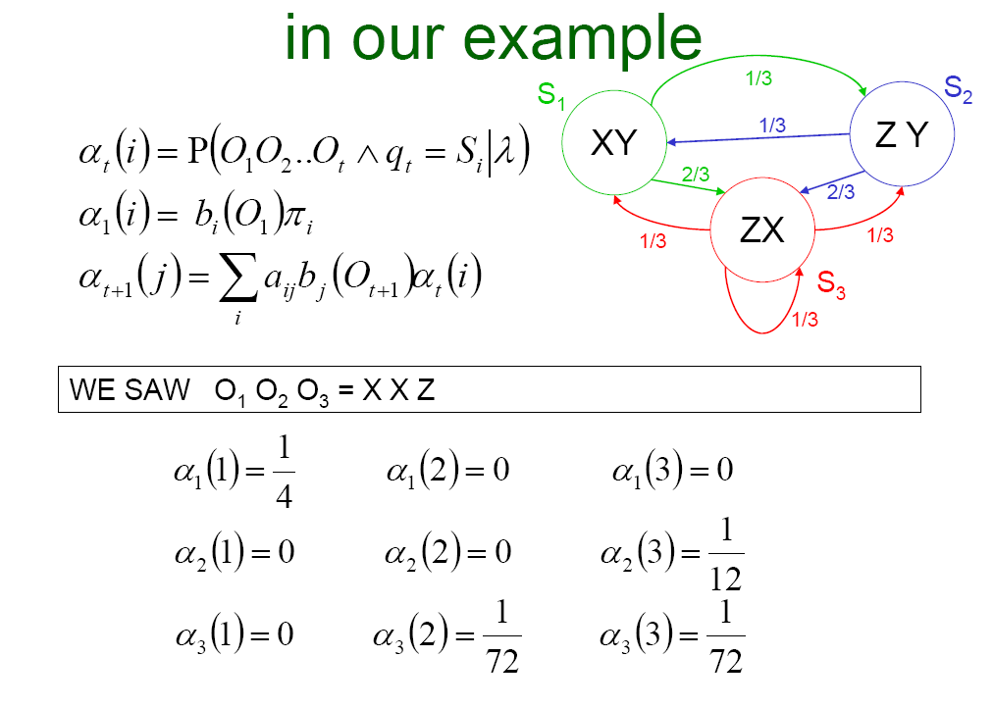
8:09
Notes:
Having the alpha we may try to predict the path

Slide 46
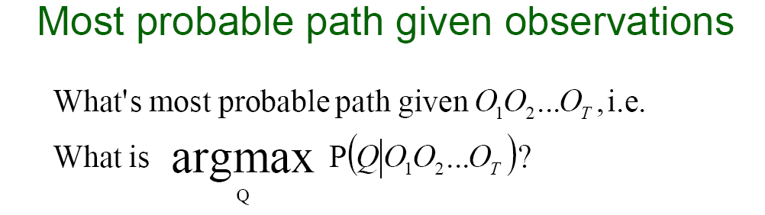
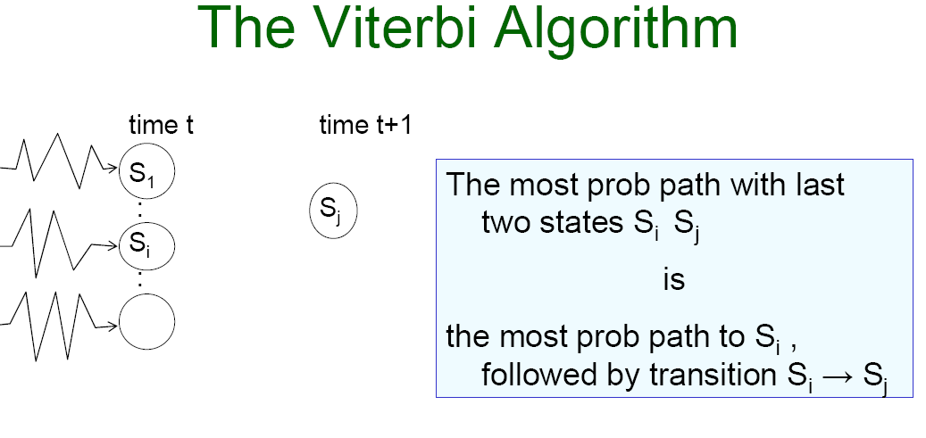

Slide 47
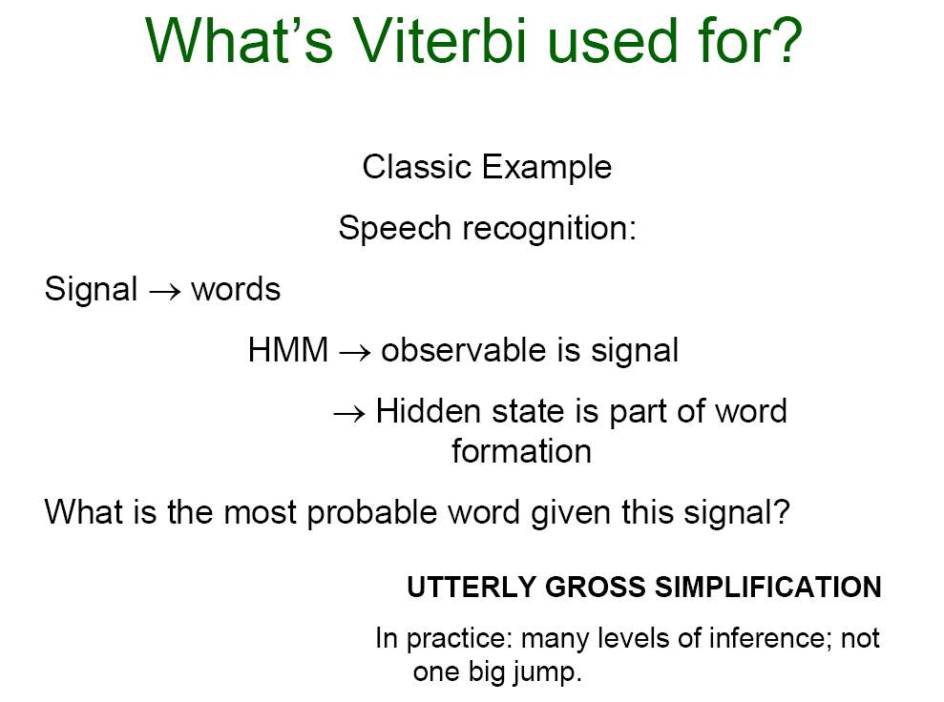

Slide 48
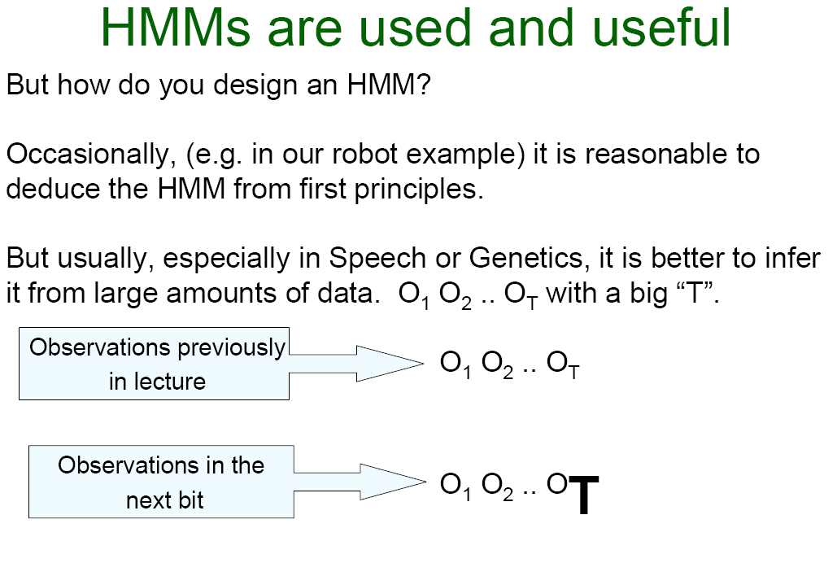

Slide 49
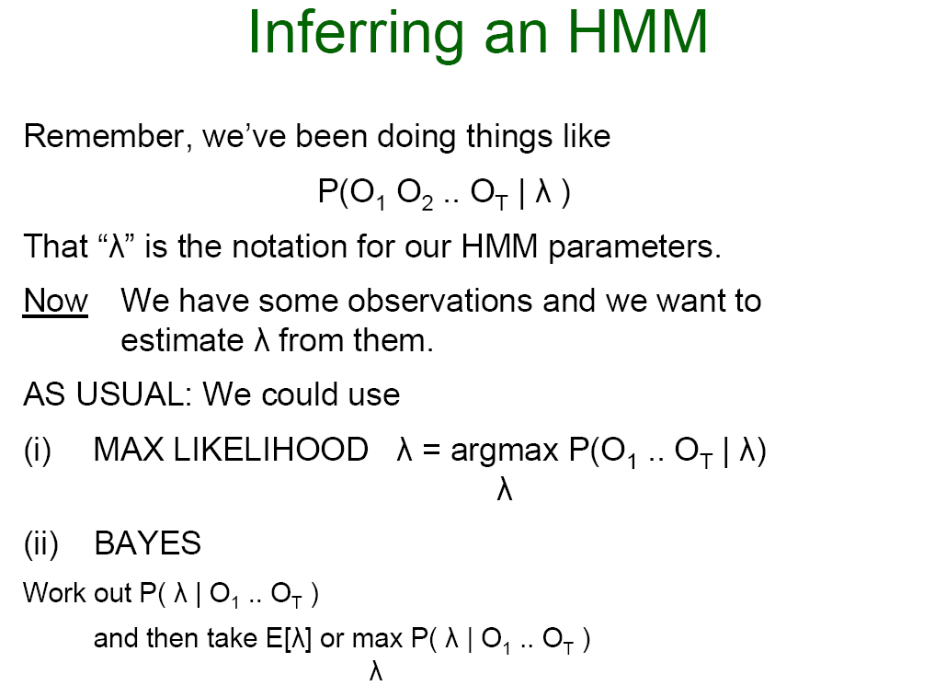

Slide 50
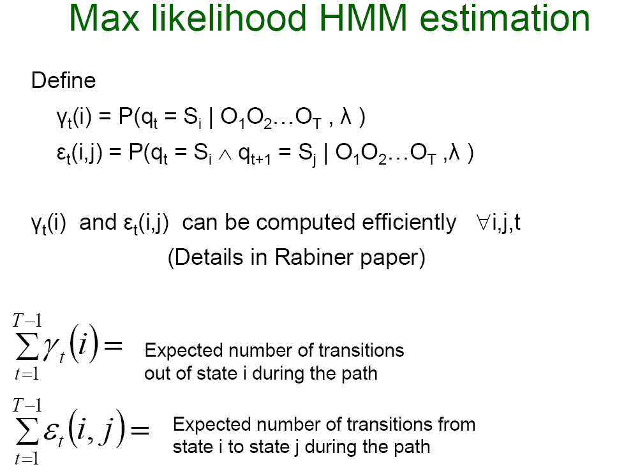
8:14

Slide 51


Slide 52
HMM in Matlab
Statistics Toolbox™ functions related to hidden Markov models are:
hmmgenerate —Generates a sequence of states and emissions (observations) from a Markov model
hmmestimate —Calculates maximum likelihood estimates of transition and emission probabilities from a sequence of emissions and a known sequence of states
hmmtrain —Calculates maximum likelihood estimates of transition and emission probabilities from a sequence of emissions
hmmviterbi —Calculates the most probable state path for a hidden Markov model
hmmdecode —Calculates the posterior state probabilities of a sequence of emissions

Slide 53
Matlab References
Hidden Markov Models in Matlab:
http://www.mathworks.com/help/stats/hidden-markov-models-hmm.html#bq_i1wh
Excellent on providing the relationship between hidden markov models, markov models, applications to speech, and HMM step by step in Matlab:
http://www.spsc.tugraz.at/system/files/hmm.pdf

Slide 54
Lecture notes: acknowledgements
Tutorial on Hidden Markov Models by Andre W. Moore:
  www.cs.cmu.edu/~awm
Course notes on Sequential Data and Markov Models by Sargur Srihari
  www.cedar.buffalo.edu/~srihari/cse574/index.html
Rabiner, L. R. (1989). A tutorial on hidden Markov models and selected applications in speech recognition.
  Proceedings of the IEEE, 77 (2), 257–286.

