Slide 1
CSC529: Advanced Data Mining
Daniela Raicu
Winter 2016

Slide 2
Lecture 3:
Performance Evaluation
Slides for Chapters 5 of Data Mining: Practical Machine Learning Tools and Techniques
by I. H. Witten, E. Frank and
M. A. Hall

Slide 3
Issues in Performance Evaluation: Outline
Training, testing, tuning
  Holdout, repeat holdout, cross-validation, leave-one-out, bootstrap (slides 5-7)
Choice of performance measure:
    Number of correct classifications
    Error for evaluating numeric predictions (slides 30-32)
  Accuracy of probability estimates: loss functions (slides 12-15)
Statistical reliability of estimated performance (→ confidence intervals)

Slide 4
Issues in Performance Evaluation: Outline (cont.)
Costs assigned to different types of errors (slides 16-27)
    Cost-sensitive measures
    Many practical applications involve costs
  The Minimum Description Length principle (slides 33-34)
  Comparing performance across multiple classifiers: the t-test (slides 8-11)

Slide 5
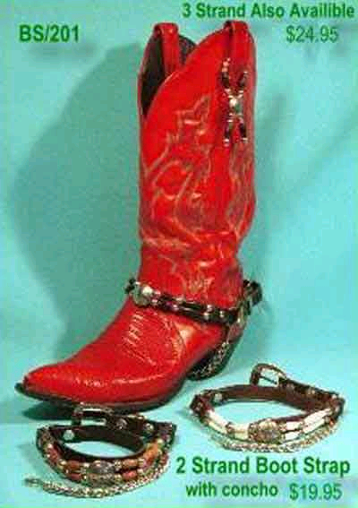
The bootstrap
CV uses sampling without replacement
  The same instance, once selected, can not be selected again for a particular training/test set
The bootstrap uses sampling with replacement to form the training set
  Sample a dataset of n instances n times with replacement to form a new dataset of n instances
  Use this data as the training set
  Use the instances from the original
  dataset that don’t occur in the new
  training set for testing

Slide 6

The 0.632 bootstrap
Also called the 0.632 bootstrap
  A particular instance has a probability of 1–1/n of not being picked
  Thus its probability of ending up in the test data is:
  This means the training data will contain approximately 63.2% of the instances

Slide 7
Estimating error with the bootstrap
The error estimate on the test data will be very pessimistic
  Trained on just ~63% of the instances
Therefore, combine it with the resubstitution error:
The resubstitution error gets less weight than the error on the test data
Repeat process several times with different replacement samples; average the results
Probably the best way of estimating performance for very small datasets

Slide 8
Comparing data mining schemes
Want to show that learning scheme A is better than learning scheme B in a particular domain
    For a given amount of training data
    On average, across all possible training sets
Let's assume we have an infinite amount of data from the domain:
    Sample infinitely many datasets of specified size
    Obtain cross-validation estimate on each dataset for each scheme
    Check if mean accuracy for scheme A is better than mean accuracy for scheme B

Slide 9
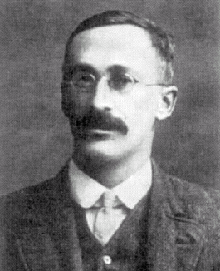
Paired t-test
In practice we have limited data and a limited number k of estimates for computing the mean
Student’s t-test tells whether the means of two samples are significantly different
In our case the samples are cross-validation estimates for different datasets from the domain
Use a paired t-test because the individual samples are paired
  The same CV is applied twice
William Gosset
Born: 1876 in Canterbury; Died: 1937 in Beaconsfield, England
Obtained a post as a chemist in the Guinness brewery in Dublin in 1899. Invented the t-test to handle small samples for quality control in brewing. Wrote under the name "Student".

Slide 10
Student’s distribution
With small number of samples (k < 100) the mean follows Student’s distribution with k–1 degrees of freedom
Confidence limits:
9 degrees of freedom normal distribution
Pr[X ≥ z]
z
Pr[X ≥ z]
z
0.1%
4.30
0.1%
3.09
Assuming
we have
10 estimates
0.5%
3.25
0.5%
2.58
1%
2.82
1%
2.33
5%
1.83
5%
1.65
10%
1.38
10%
1.28
20%
0.88
20%
0.84

Slide 11
Performing the test
Fix a significance α% level
    If a difference is significant at the α% level,
    there is a (100-α)% chance that the true means differ
Divide the significance level by two because the test is two-tailed
    I.e. the true difference can be greater or equal than zero
Look up the value for t that corresponds to α/2
If t ≤ –t(α/2) or t ≥ t(α/2) then the difference is significant
    I.e. the null hypothesis (that the difference is zero) can be rejected

Slide 12
Predicting probabilities
Performance measure so far: success rate
  Also called 0-1 loss function: loss is 0 for a correct prediction and 1 for an incorrect one
Most classifiers produces class probabilities
  Depending on the application, we might want to check the accuracy of the probability estimates
  0-1 loss is not the right thing to use in those cases

Slide 13
Quadratic loss function
p₁ … p_{k} are probability estimates for an instance
c is the index of the instance’s actual class
a₁ … a_{k} = 0, except for a_{c} which is 1
Quadratic loss for each instance is:
Want to minimize
Can show that this is minimized when p_{j} = p_{j}*, the true probabilities

Slide 14
Informational loss function
The informational loss function is –log(p_{c}),
where c is the index of the instance’s actual class
Number of bits required to communicate the actual class
Let p₁* … p_{k}* be the true class probabilities. Then the expected value for the loss function is:
–p1*log(p₁)-…-pk*log(pk)
Justification: minimized when p_{j} = p_{j}*
Difficulty: zero-frequency problem

Slide 15
Discussion
Which loss function to choose?
  Both encourage honesty
  Quadratic loss function takes into account all class probability estimates for an instance
  Informational loss focuses only on the probability estimate for the actual class
  Quadratic loss is bounded:
  it can never exceed 2
  Informational loss can be infinite
Informational loss is related to MDL principle [later]

Slide 16
Cost-sensitive evaluation
In practice, different types of classification errors often incur different costs
Examples:
  Medical diagnosis:
    Cost of false positive error: unnecessary treatment; unnecessary worry
    Cost of false negative error: Postponed treatment or failure to treat; death or injury
  Oil-slick detection
  Fraud detection
  Promotional mailing

Slide 17
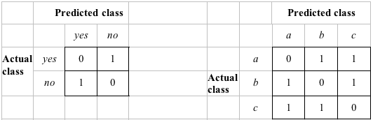
Cost-sensitive evaluation
The confusion matrix:
Predicted class
Yes
No
Actual class
Yes
True positive
False negative
No
False positive
True negative
Examples of two cost matrices:
Cost is given by appropriate entry in the cost matrix
Success rate is replaced by average cost per prediction

Slide 18
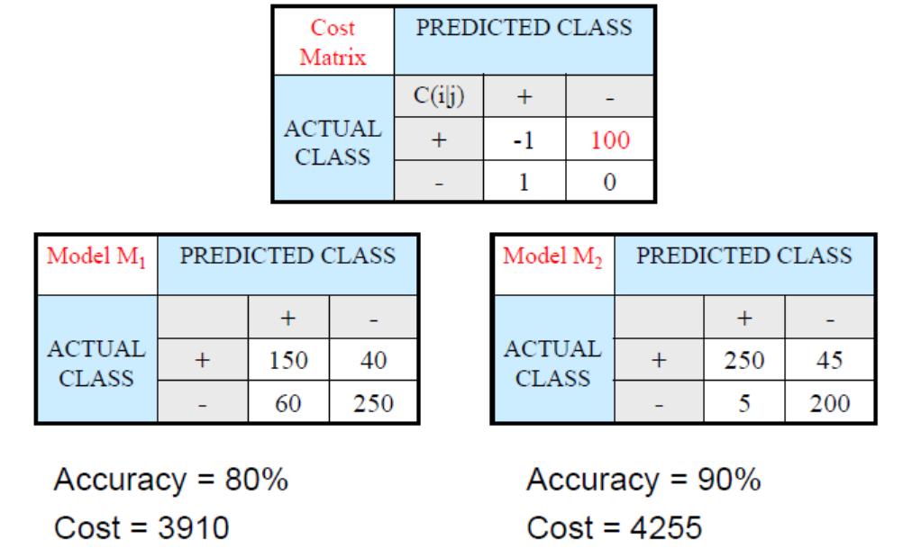
Cost-sensitive evaluation: Example

Slide 19
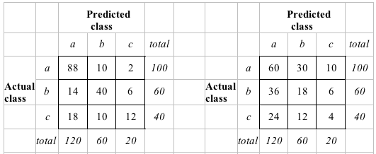
Aside: the kappa statistic
Two confusion matrices for a 3-class problem:
actual predictor (left) vs. random predictor (right)
Number of successes: sum of entries in diagonal (D)
Kappa statistic: (140-82)/(200-82)=.492
measures relative improvement over random predictor

Slide 20
Counting the cost
There are many types of cost besides the cost of making the errors!
  Examples:
  Cost of collecting training data → imbalance data
  Cost of improving performance
  When the costs are integrated in the learning algorithm, the algorithm is called cost-sensitive learning

Slide 21
Cost-sensitive learning
So far we haven't taken costs into account at training time
Most learning schemes do not perform cost-sensitive learning
  They generate the same classifier no matter what costs are assigned to the different classes
  Example: standard decision tree learner
Methods for cost-sensitive learning:
  Modify the inputs to the learning algorithm to reflect the costs
  Modify the learning algorithm to integrate the costs

Slide 22
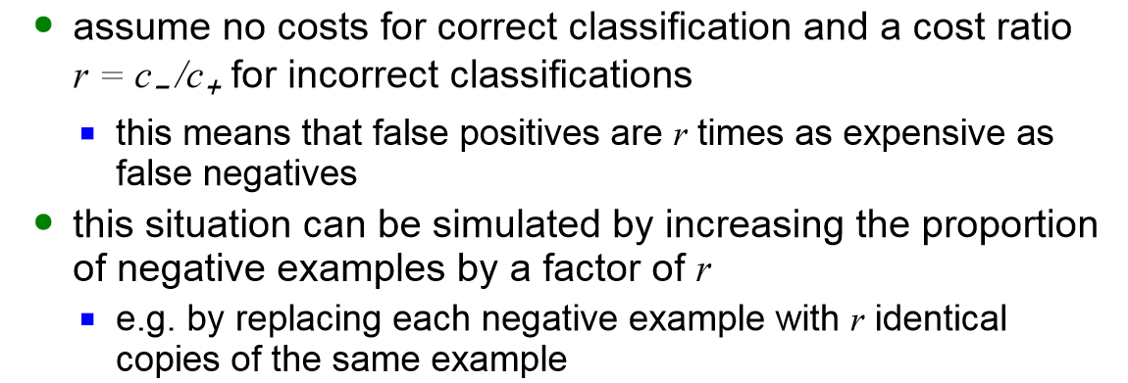
Cost-sensitive learning
Methods for cost-sensitive learning:
  Modify the inputs to the learning algorithm to reflect the costs
      Re-sampling of instances according to costs

Slide 23
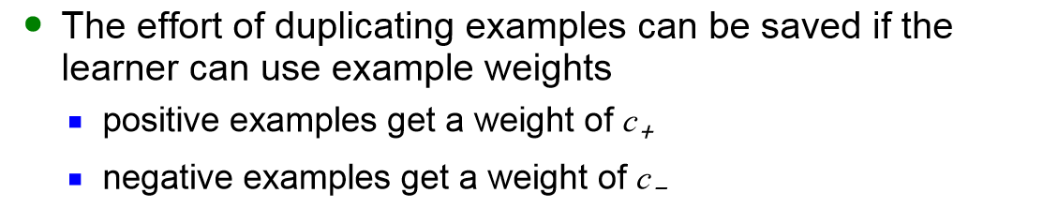
Cost-sensitive learning
Methods for cost-sensitive learning:
  Modify the inputs to the learning algorithm to reflect the costs
      Weighting of instances according to costs
    Examples of weights (where c- is the cost of false negatives and c+ is the cost of false positive)

Slide 24
Cost-sensitive learning
Methods for cost-sensitive learning:
  Modify the learning algorithm to include the costs
    Cost-sensitive boosting
    Cost can be incorporated directly into the error criterion when training neural networks (Kukar and Kononenko, 1998)

Slide 25
Lift charts
In practice, costs are rarely known
Decisions are usually made by comparing possible scenarios
Example: promotional mailout to 1,000,000 households
  Mail to all; 0.1% respond (1000)
  Data mining tool identifies subset of 100,000 most promising, 0.4% of these respond (400)
  40% of responses for 10% of cost may pay off
  Identify subset of 400,000 most promising, 0.2% respond (800)
A lift chart allows a visual comparison

Slide 26
Generating a gain chart
Sort instances according to predicted probability of being positive:
x axis is sample size
y axis is number of true positives
Predicted probability
Actual class
1
0.95
Yes
2
0.93
Yes
3
0.93
No
4
0.88
Yes
…
…
…

Slide 27
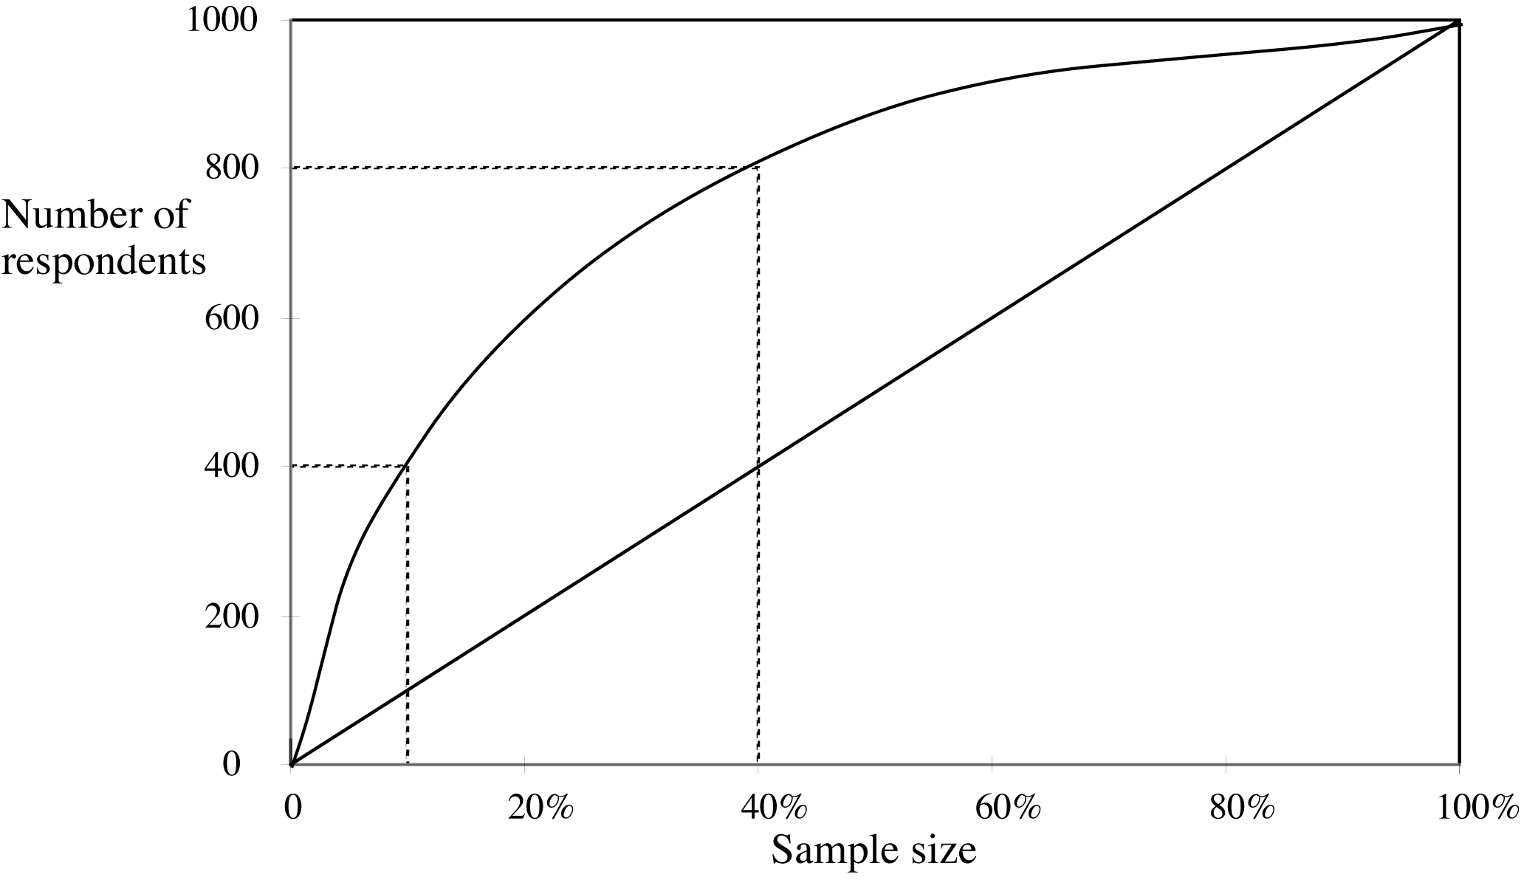
A hypothetical cumulative gain chart (see handout on lift charts)
40% of responses
for 10% of cost
80% of responses
for 40% of cost

Slide 28
ROC curves
ROC curves are similar to lift charts
  Stands for “receiver operating characteristic”
  Used in signal detection to show tradeoff between hit rate and false alarm rate over noisy channel
Differences to lift chart:
  y axis shows percentage of true positives in sample rather than absolute number
  x axis shows percentage of false positives in sample rather than sample size

Slide 29
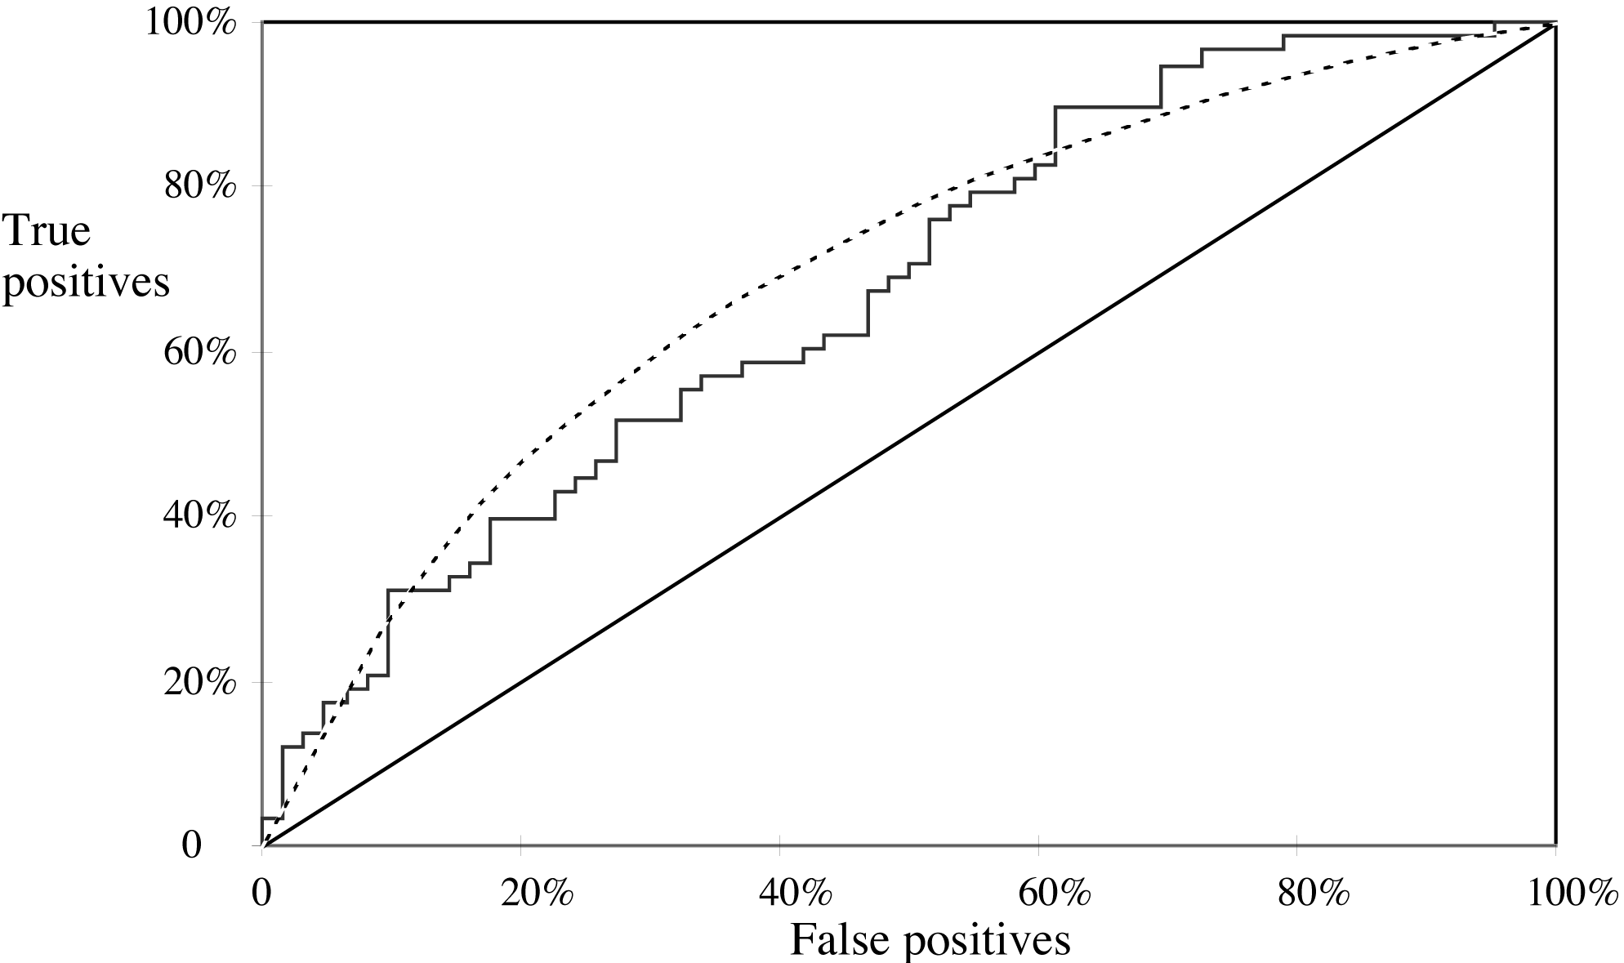
A sample ROC curve
Jagged curve—one set of test data
Smooth curve—use cross-validation

Slide 30
More measures...
Percentage of retrieved documents that are relevant: precision=TP/(TP+FP)
Percentage of relevant documents that are returned:
recall =TP/(TP+FN)
Precision/recall curves have hyperbolic shape
Summary measures: average precision at 20%, 50% and 80% recall (three-point average recall)
F-measure=(2 × recall × precision)/(recall+precision)
sensitivity × specificity = (TP / (TP + FN)) × (TN / (FP + TN))
Area under the ROC curve (AUC):
probability that randomly chosen positive instance is ranked above randomly chosen negative one

Slide 31
Evaluating numeric prediction (Table 5.8)
Actual target values: a₁ a₂ …a_{n}
Predicted target values: p₁ p₂ … p_{n}
Most popular measure: mean-squared error (MSE)
    Easy to manipulate mathematically
  Root MSE
  Mean absolute error
  Relative-squared error
  Root relative squared error
  Relative absolute error
  Correlation coefficient

Slide 32
Which measure?
Best to look at all of them
Often it doesn’t matter
Example:
A
B
C
D
Root mean-squared error
67.8
91.7
63.3
57.4
Mean absolute error
41.3
38.5
33.4
29.2
Root rel squared error
42.2%
57.2%
39.4%
35.8%
Relative absolute error
43.1%
40.1%
34.8%
30.4%
Correlation coefficient
0.88
0.88
0.89
0.91
D best
C second-best
A, B arguable

Slide 33
The MDL principle
MDL stands for minimum description length
The description length is defined as:
space required to describe a theory
+
space required to describe the theory’s mistakes
In our case the theory is the classifier and the mistakes are the errors on the training data
Aim: we seek a classifier with minimal DL
MDL principle is a model selection criterion

Slide 34
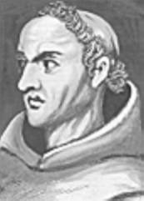
Model selection criteria
Model selection criteria attempt to find a good compromise between:
  The complexity of a model
  Its prediction accuracy on the training data
Reasoning: a good model is a simple model that achieves high accuracy on the given data
Also known as Occam’s Razor :
the best theory is the smallest one
that describes all the facts
William of Ockham, born in the village of Ockham in Surrey (England) about 1285, was the most influential philosopher of the 14th century and a controversial theologian.

Slide 35
Elegance vs. errors
Theory 1: very simple, elegant theory that explains the data almost perfectly
Theory 2: significantly more complex theory that reproduces the data without mistakes
Theory 1 is probably preferable

Slide 36
Summary of the lecture
How to sample the data to provide reliable estimates?
  - Holdout procedure, cross-validation, leave-one out, bootstrap
How to measure statistically reliability of estimators?
  - confidence intervals
  How to compare data mining schemes?
  - t-tests

Slide 37
Summary of the lecture (cont.)
  How to measure classification performance?
  - error rate (substitution, generalization)
  - loss-function for probabilistic classifiers
  - measures for numeric predictions
  How to visualize performance for probabilistic classifiers?
  - Lift curves
  - ROC Curves
  How to take costs into account?
  - classification costs
  - cost sensitive learning

Slide 38
Interesting related papers
S. Vijayanarasimhan and K. Grauman, “Cost-Sensitive Active Visual Category Learning”, Intl. Journal of Computer Vision (IJCV), Vol. 91, Issue 1 (2011). http://vision.cs.utexas.edu/projects/others/ijcv-preprint.pdf
M. E. Ramirez-Loaiza, A. Culotta and M. Bilgic, “Towards Anytime Active Learning: Interrupting Experts to Reduce Annotation Costs,” in Proceedings of the 19th Conference on Knowledge Discovery and Data Mining, Chicago, IL, August 2013.
http://poloclub.gatech.edu/idea2013/papers/p88-ramirez.pdf

